Slide 1
Introduction to Bankruptcy Law and the Bankruptcy System: An Educational Primer for State Courts [Template Presentation For Educational Use]
This template presentation, provided by the Federal Judicial Center, combines, edits, and expands presentations given by bankruptcy judges and state trial court judges. Contact Jason A. Cantone, at fedstate@fjc.gov, for more information.
Notes:
This presentation was greatly benefitted by the following individuals, who reviewed an earlier draft of the presentation: Hon. Shon Hastings, Hon. Craig Whitley, Hon. Cate Furay, Hon. Charles L. Nail, Jr., Hon. Ashely Chan, Hon. Robert Kressel, Hon. Robert Drain, Hon. Diane Finkle, Hon. Robert Faris, Elizabeth Wiggins, and Brian Lynch. The presentation utilizes and expands on prior educational materials provided alongside interviews held by Dr. Jason Cantone with: Hon. Dan Collins, Hon. Brian Davis, Hon. Robert Faris, Hon. Cate Furay, Hon. Martin Glenn, Hon. A. Benjamin Goldgar, Hon. Mary Gorman, Hon. Laurel Isicoff, Hon. Catherine McEwen, Hon. Robyn Moberly, Hon. Mindy Mora, Hon. Chris Panos, Hon. Laura Taylor, and Ann M. Anderson. This presentation was made better by all of these individuals, as well as the Judicial Conference Committee on Federal-State Jurisdiction.

Slide 2
Content Note
This presentation only addresses related family law issues. A full presentation with all six topics (bankruptcy overview; automatic stay; bankruptcy discharge; family law; foreclosure; additional considerations) is available at fjc.gov/fedstate, as well as separate presentations for each of those topics.
Notes:
If you would like a Powerpoint that includes the full presentation or the topics provided in the note, please visit fjc.gov/fedstate.

Slide 3
Bankruptcy and Family Law

Slide 4
Domestic Support Obligation (DSO) 11 U.S.C. §101(14A)
Domestic Support Obligation: a debt that accrues before, on, or after the date of the order for relief in a case under this title, including interest that accrues on that debt as provided under applicable nonbankruptcy law notwithstanding any other provision of this title, that is:
Owed to or recoverable by:
(i) a spouse, former spouse, or child of the debtor or such child’s parent, legal guardian, or responsible relative; or
(ii) a governmental unit
In the nature of alimony, maintenance, or support (including assistance provided by governmental unit) of such spouse, former spouse, or child of the debtor or such child’s parent, without regard to whether such debt is expressly so designated.

Slide 5
Domestic Support Obligation (DSO) 11 U.S.C. §101(14A)
Established or subject to establishment before, on, or after the date of the order for relief in a case under this title, by reason of applicable provisions of:
(i) a separation agreement, divorce decree, or property settlement agreement;
(ii) an order of a court of record; or
(iii) a determination made in accordance with applicable nonbankruptcy law by a governmental unit; and
Not assigned to a nongovernmental entity, unless that obligation is assigned voluntarily by the spouse, former spouse, child of the debtor, or such child’s parent, legal guardian, or responsible relative for the purpose of collecting the debt.

Slide 6
Domestic Support Obligation (DSO) 11 U.S.C. §101(14A)
Additional notes regarding the DSO:
excepted from automatic stay
excepted from discharge
higher priority than almost all other claims

Slide 7
Automatic Stay and Family Law 11 U.S.C. §362(b)
Bankruptcy does not operate as a stay—
Of the commencement or continuation of a:
Criminal action or proceeding against the debtor;
Civil action or proceeding
for the establishment of paternity
for the establishment or modification of an order for domestic support obligation
concerning child custody or visitation
for the dissolution of a marriage, except to the extent that such proceeding seeks to determine the division of property that is property of the estate
regarding domestic violence
Of the collection of a domestic support obligation from property that is not property of the estate;
With respect to the withholding of income that is property of the estate or property of the debtor for payment of a domestic support obligation under a judicial or administrative order or a statute.

Slide 8
Family Law and Estate Property
Property not in the estate:
funds held in certain retirement and education savings accounts
in a Chapter 7 case, earnings from personal services rendered after bankruptcy date
BUT: in Chapters 11, 12 and 13, such earnings ARE included in the estate.
most property acquired after filing in a Chapter 7 case is not included
exempt property (only after the exemption has been allowed)
inheritances received more than 180 days postbankruptcy
abandoned property

Slide 9
DSOs and the Discharge in Chapter 7
The discharge in a Chapter 7 case does NOT discharge an individual from debt
for a DSO
to a spouse, former spouse, or child of the debtor that is NOT a DSO and that is incurred by the debtor in the course of a divorce or separation or in connection with a separation agreement, divorce decree, or other order of a court of record, or a determination made in accordance with state or territorial law by a governmental unit

Slide 10
DSOs and the Discharge in Chapter 13
Advice:
Make sure to examine if, in Chapter 13:
DSOs are characterized in a way that makes these debts vulnerable to discharge
Non-DSO divorce obligations (such as equalization payments) are discharged

Slide 11
Priority of DSO Claims (Generally)
Secured creditors
DSOs (but review!)
Allowed administrative expenses
Priority claims (unsecured)
General unsecured claims
Equity (shareholders, partners, individual debtor)
11 U.S.C. §507(a)

Slide 12
Who Decides What Is a DSO?
Bankruptcy court will decide if a claim is a DSO for purposes of priority and automatic stay relief.
State courts have concurrent jurisdiction with the bankruptcy courts to determine that a particular debt is a DSO excepted from automatic stay or discharge.

Slide 13
Jurisdiction and the Discharge: Domestic Support Obligations
Federal law defines the DSO, but the intention of the court or parties creating the obligation is the key fact.
If a claim is “in the nature of alimony, maintenance, or support,” state judges should clearly state this.
The problem is hardest with respect to debt allocations, hold-harmless agreements, and any other third-party obligation such as attorney fees.

Slide 14
Jurisdiction and the Discharge: Domestic Support Obligations
Advice:
Sometimes matrimonial lawyers put these findings in proposed orders.
The state court should be aware when this occurs and might want to make sure opposing counsel is aware.
At times, both sides might agree to the language to the detriment of the creditors of one or both parties.

Slide 15
Factors Considered by Bankruptcy Court to Determine if Obligation Is a DSO
Whether payments terminate upon death or remarriage of the spouse receiving them.
Whether payments terminate when minor child reaches a certain age.
Whether payments are contingent on future earning abilities.
Whether payments are to be periodic over a long period of time rather than in a lump sum.
Whether the payments are designated as being for purposes such as medical care, housing, or other needs of the spouse or children.

Slide 16
Sample Language to Protect Judgments
Nondischargeable attorney fees:
“In order to ensure that [the partner] can afford to support [themselves] and the children, [the other partner] shall pay the sum of $____ as and for the [partner]’s attorney fees and costs.”
Obligation to pay a joint debt:
“Relieving [the partner] of [their] obligation to pay the joint debts is necessary to enable [the partner] to maintain the family home and provide [their] share of support for the minor children.”
Notes:
Note: To remove gendered language, words are bracketed here. They can be replaced with wife/husband as needed.

Slide 17
Sample Language to Protect Judgments
Monetary award as a DSO:
“The payment of $_______ is to provide for the support and living expenses of the spouse or minor child; or [the payment of $____ is intended to pay for the mortgage on a home] or [other necessities for the child or the spouse.]”
Notes:
Note: To remove gendered language, words are bracketed here. They can be replaced with wife/husband as needed.

Slide 18
Child Support, Maintenance, or Attorneys’ Fees in Divorce: Can a Bankruptcy Court Examine or Undo Your Awards?
Yes.
The bankruptcy court may need to decide whether the award fits the bankruptcy definition of a “domestic support obligation.” Characterization of the award and its relation to property division is sometimes reviewed. Your findings and conclusions can assist the bankruptcy court and may have preclusive effect.
The state court’s division of assets might be affected if its characterizations are inconsistent with the parties’ true intentions and dischargeability rights of the debtor.
Decision can vary by jurisdiction. For example, in the Fourth Circuit, the state court makes the domestic divisions, and the bankruptcy court then reviews and enforces against the debtor and estate property under bankruptcy law.

Slide 19
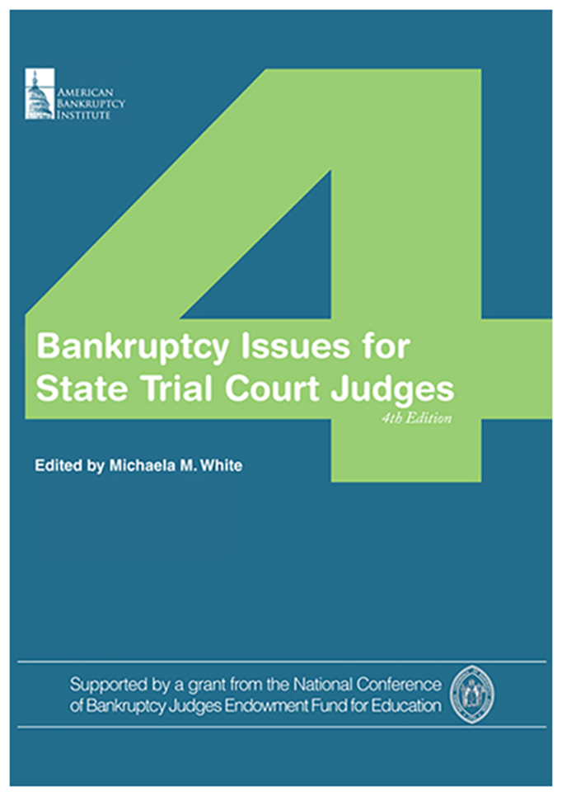
Additional Resources
Federal Judicial Center website on federal-state cooperation: https://fjc.gov/fedstate
National Center for State Courts resource guide on foreclosures: https://www.ncsc.org/Topics/Financial/Foreclosures/Resource-Guide.aspx

Slide 20
Thank You
This presentation was organized by Federal Judicial Center Senior Research Associate Jason A. Cantone, with considerable assistance by a number of federal and state judges and court personnel (see note for slide 1).
Questions about the presentation and its use can be directed to Dr. Cantone, at fedstate@fjc.gov. We would also like to hear from you if you find it helpful or have any recommendations to improve it.

